Slide 1

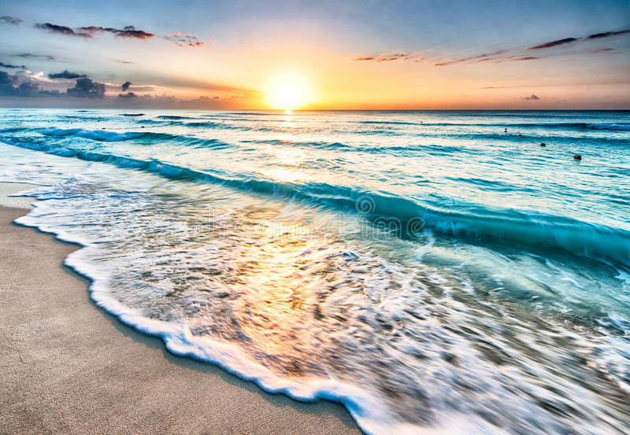
MIC Smart Beach by Bruce County
for Dr. Alex Smith
Sanjeev Kumar - Professor
Brunilda Xhaferllari – Project Manager
Rich Freeman – Faculty Mentor
AI Team:
Janvi Patel
Fangji Chen
Scaria Ouseph Kurian
Date: 02-09-2023
Notes:
Image: 12019 (2016) Ocean waves crashing on shore during daytime https://pixabay.com/photos/beach-sea-sunset-sun-sunlight-1751455/

Slide 2
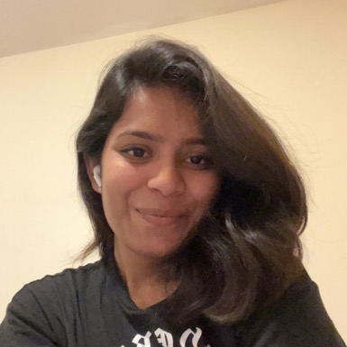
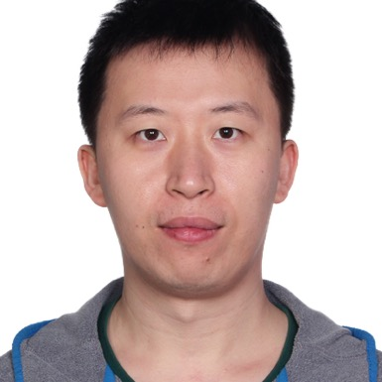
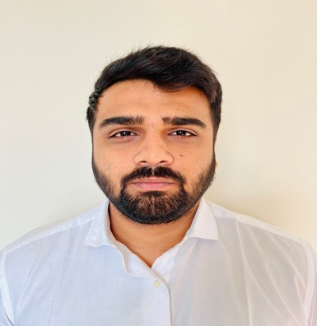

Our Team
Janvi
Patel
Scaria Ouseph Kurian
Fangji Chen
Project Lead / Communicator
Developer
Analyst

Slide 3

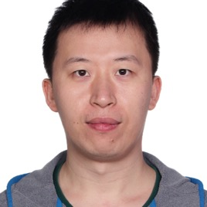
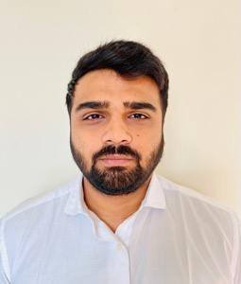
Who we are
I have a Bachelor of Computer Science degree from GTU. Prior to the Big Data Analysis program at Georgian College, I was a software developer. In terms of skills, I have high communication and organization with intermediate level experience in Python, Power BI, Machine Learning, and Deep Learning. I look forward to this project and our future weeks together.
I have a bachelor's degree in electronic information engineering and have 10 years of working experience in software engineering, data mining, and machine learning after graduating. I'm glad to work on this project and move forward with the group.
I have a Bachelor’s degree in computer science and a postgraduate program in Big Data Analytics and now I’m pursuing Artificial intelligence at Georgian college. I have an intermediate level experience in Power BI, Machine Learning, and Python. I’m glad to work on this project and move forward with this group.

Slide 4
Project Summary
The smart beach project is a three year pilot project that will provide swimmers with up-to-date information on water conditions.
The general project agenda is to use buoy(National oceanic and atmospheric administration) data and camera images to predict future water conditions.
There are 3 questions provided by MIC to the whole team of the which AI team will be working on the following question.
Predict the wave conditions and current visible in the camera images, as well the number and distribution of people on the beach and in the water.

Slide 5
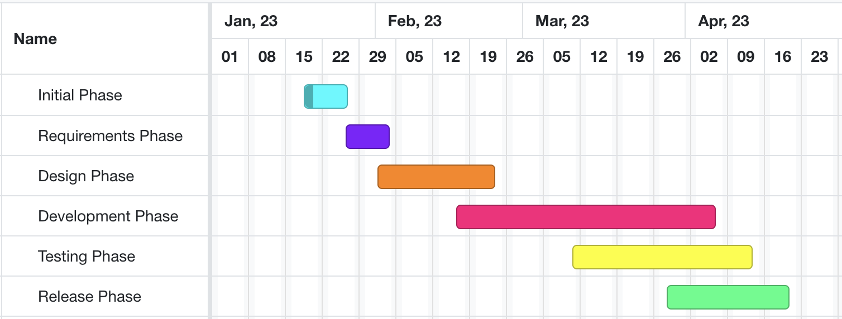
High-level GANTT Chart

Slide 6

Additional activities since last report
Work:
We were working on Image Classification.
There are few models to compare accuracy.
CSRNet
Faster R-CNN
DenseNet
Notes:
Padrinan, Miguel (n.d.). Email blocks on Gray Surface. Accessed on January 16th, 2023 from https://www.pexels.com/photo/email-blocks-on-gray-surface-1591062/

Slide 7
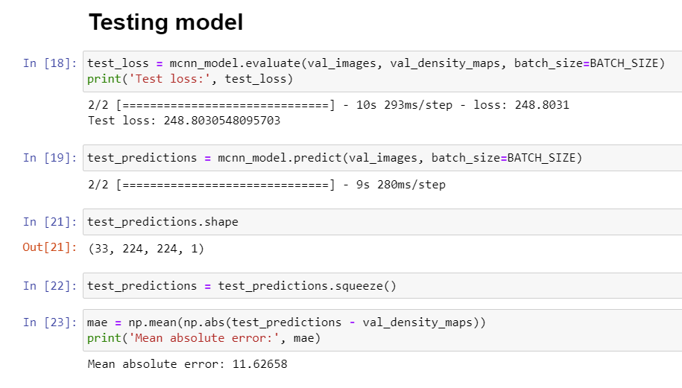
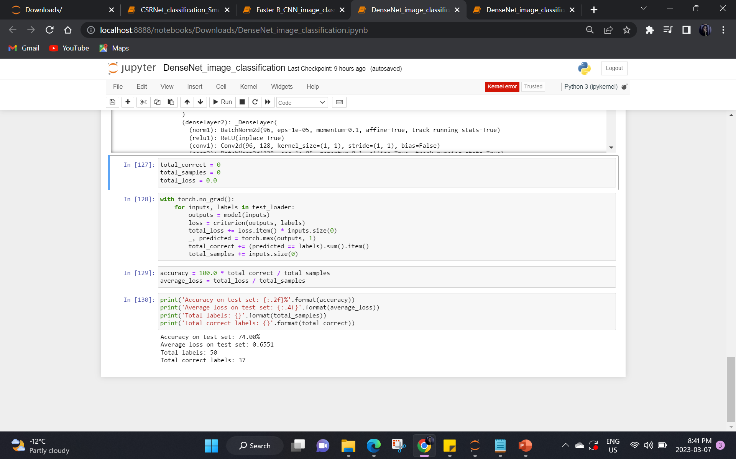
Model Comparision
CSRNet
DenseNet

Slide 8
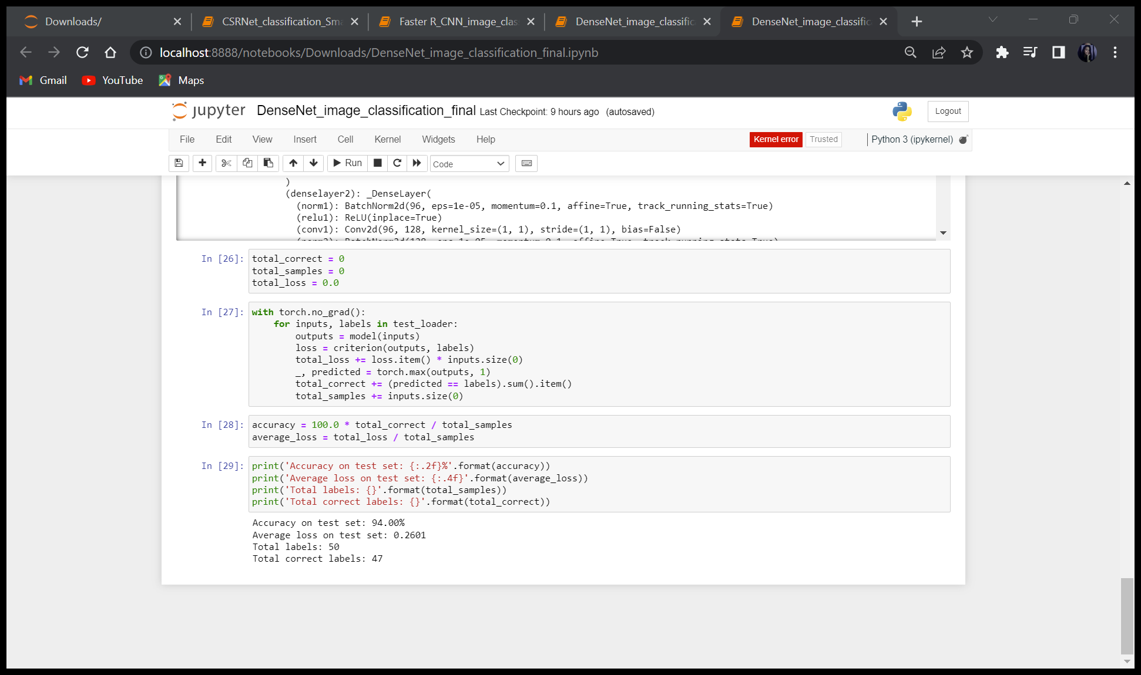
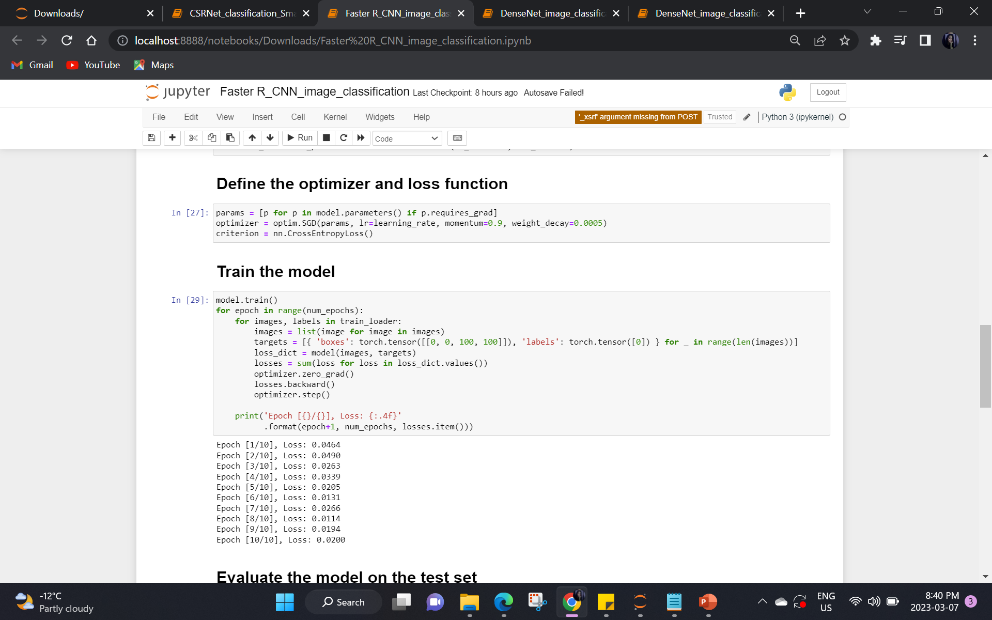
Model Comparision
DenseNet with 50 epoch
Faster RCNN

Slide 9
Complexities in models:
CSRNet:
The CSRNet model has an average loss of around 248. Making the accuracy way lower.
DenseNet:
The DenseNet model with 10 epochs gave an accuracy of about 74%. After increasing the epoch count to 50 the accuracy increased drastically to 94%.
Faster R-CNN:
The RCNN model has the lowest average loss, even less than 0.05. Which will give the best output for classification. Also, RCNN will allow us to classify on the bases of the region as well.

Slide 10
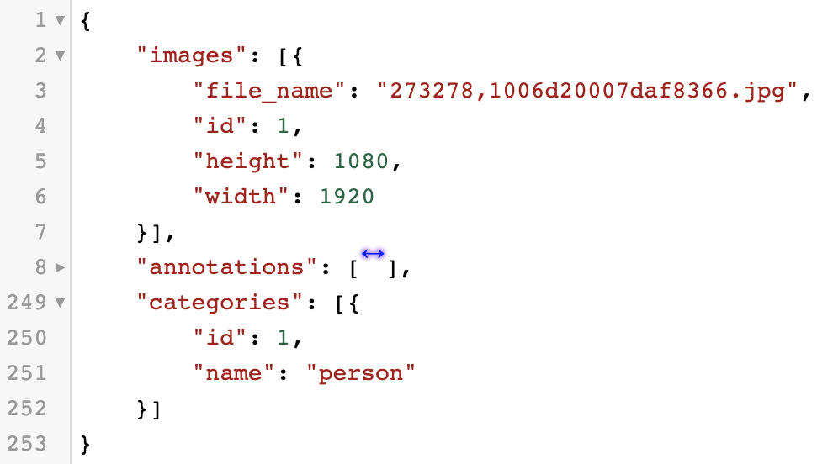
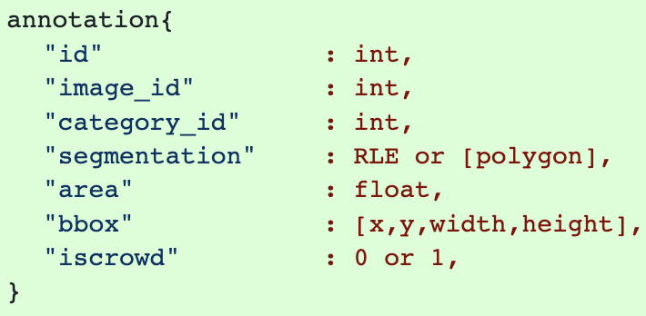
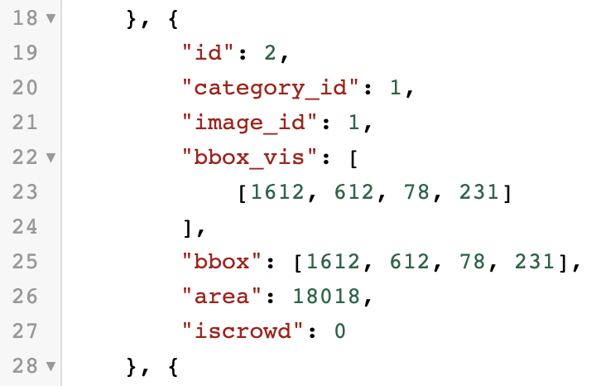
Individual Status Report – Fangi
Model performance metrics under the form of COCO Annotations
COCO annotation format:
Annotate images and make prediction and calculate metrics

Slide 11
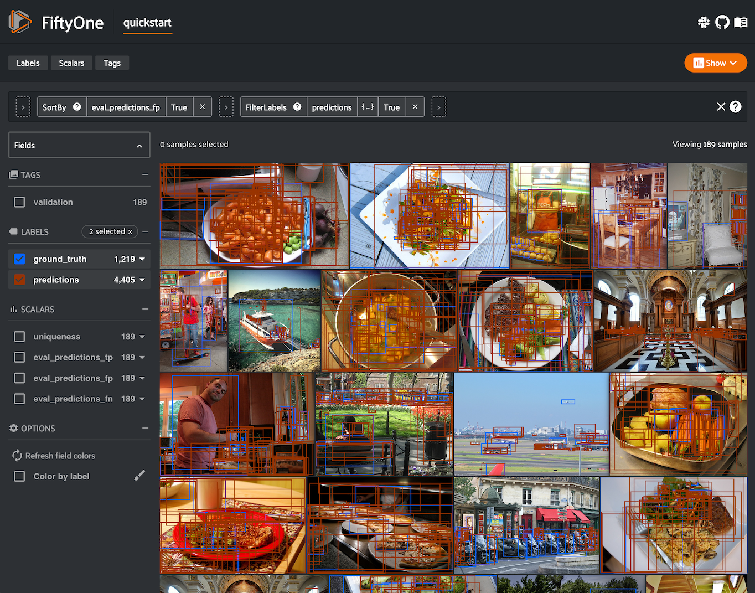
Individual Status Report – Fangi
Model performance metrics under the form of COCO Annotations
Working on COCO annotation standards to evaluate model performance on Bruce Beach camera images.

Slide 12

Activities to be Completed before Next report:
Implementing classification model RCNN.
After finding the classes, we will look for the best crowd-counting model that fits each class.
Plan for now?
Crowd Counting
Notes:
Olexa, Peter (n.d.) A Person Making a Schedule. Accessed on January 18th, 2023 from https://www.pexels.com/photo/a-person-making-a-schedule-14299948/

Slide 13
Thank you!
Questions?
Notes:
Image: Leloo, The first (2022) https://www.pexels.com/photo/question-marks-on-paper-crafts-5428833/

